Slide 1

Promoting Growth Towards the Ideal Christian Leader
(Perry Shaw)

Slide 2
Videos:
BadLanding
MD-80 hard landing_1
On Our Way to the Dance

Slide 3
Promoting Growth Towards the Ideal Christian Leader
With the person next to you:
How do you determine whether your students are growing in faith and practice while they are with you? How do you assess whether your programmes are actually accomplishing the school’s purpose of existence?
Describe one or two actions that you and/or your school have taken recently to monitor and strengthen holistic growth in your students.

Slide 4
What is required in higher education?
(The Bologna Process)
Fitness of Purpose
To what extent is the stated purpose of the school appropriate for the programme of study?
Does the stated purpose accurately describe the nature of the work [ministry] in which the graduates are likely to be engaged? To what extent does it reflect what the alumni are currently doing?
Is the “Profile” an accurate and holistic picture of an ideal graduate – one who would be multi-dimensionally outstanding in the work [ministry] context for which the programme is ostensibly designed?
Fitness for Purpose
To what extent does the stated purpose of the school drive the curricular structure? The administrative structures?
What evidence is there of accountability of the administration and faculty to the stated purpose of the school? To the constituency?

Slide 5
What are we trying to do anyway?

Slide 6
CTC II.4
  “Those of us who provide theological education need to ensure that it is intentionally missional, since its place within the academy is not an end in itself, but to serve the mission of the Church in the world.”

Slide 7
The Calling: The Kingdom of God
The Means: The Church
The Challenges: Internal and External
The Need: Faithful men and women
The Mandate of our Training Programs:
to train faithful men and women who know how to help the church in their context to address the challenges and hence fulfil its mission of having Christ acknowledged as Lord throughout the earth

Slide 8
Process in Theological Education
Input
Bricks, Books, Bucks, Bodies
Resources
Impact
Longer-term societal change
Society
Activity
Theological Education
Curriculum
Output
Change as a result of the activity
Graduates
Outcome
Change as a result of the output
Churches

Slide 9
The Pilgrimage of Faithful Men and Women
What do we long for them to be? Effective men and women for an effective church.
Our Curriculum
Who are they when they come?
What might they be when they leave?
The Emerging Leader’s Time With Us:
Where?
When?
Who are the Facilitators?
How might we prepare them for lifelong growth?

Slide 10
  The Right Questions
  What is the Ideal Church in Our Context?
  What are the Contextual Challenges?
  What Might an Effective Faithful Christian Look Like?
  Who are the Learners?
  Where Do the Students Go?
  When? The Time Frame.
  Where? The Learning Context.
  Who Will Facilitate the Learning?
  What and How?

Slide 11
Who should be involved in answering questions 1 to 3?
You need the people best equipped to answer the questions:
  People at every level in the churches
  Christians in the community
  Evangelists and mission theologians
  People who are capable of double-loop thinking
However, ultimately it is the faculty who must implement the final curriculum, and consequently they must buy in to the process.

Slide 12
  The Right Questions
  What is the Ideal Church in Our Context?
  What are the Contextual Challenges?

Slide 13

The Contextual Challenges
  What are some of the challenges that confront the church, that hinder it as an effective agency for the proclamation of Christ in word and action?
  Consider both:
  external challenges (how the societal context hinders proclamation), and
  internal challenges (particular chronic weaknesses within the Christian faith community).
  In this process, depth rather than breadth is preferable: that is, rather than having a long list of short items you begin with one or two major issues and consider what lies behind the issue and what are some of the implications of the issues.

Slide 14
Some Basic Questions
  For local church leaders:
  Name two or three of the most significant challenges that face the church in your region today.
  Name one or two of the greatest weaknesses you observe in local churches in your region.
  Based on your experience of churches that have impact on their communities, describe two or three of the most important characteristics of leaders that can help churches accomplish impact.
  For community leaders:
  What are one or two significant ways in which local churches in your district might better serve your community.

Slide 15
  The Right Questions
  What is the Ideal Church in Our Context?
  What are the Contextual Challenges?
  What Might an Effective Faithful Christian Look Like?

Slide 16
  What are the most important attitudes, motivations, desires, and character traits that an effective leader needs to have to help the church address the challenges? (the Affective domain of learning)
  What are the most important skills and habits of life that an effective leader needs to have to help the church address the challenges? (the Behavioural domain of learning)
  What knowledge and reflective abilities does an effective leader need to have to help the church address the challenges? How might an effective leader continue growing and learning throughout the years of life and ministry? (the Cognitive domain of learning)

Slide 17
ABTS Graduate Requirements
The most important characteristic we should seek in students is a teachable spirit – a commitment to grow as servant-leaders while they are with us – cognitively, affectively, behaviourally. If the students demonstrate a commitment to self-initiated holistic growth, they are more likely to continue this pattern after graduation. Consequently the elements we seek to see in students as they move towards graduation include the following:
A teachable spirit – not just in academic courses but also in personal and ministerial formation. Of particular concern is to see a teachable spirit even where ABTS is not providing boundaries and direction.
Reducing levels of ABTS-initiated “maintenance”. While some students may need substantial “maintenance” at the beginning of their time with us, if this continues into the second and third years we should question their long-term effectiveness as leaders.
An increasingly positive influence on other students, particularly first year students. We recognize that a growing relationship with God should be reflected in a growing positive influence on other students.
Self-initiated disciplines of growth, where students recognize an area of weakness and take positive steps to address these weaknesses.
At your theological college what would be your priorities? [ABTS is fully residential.]

Slide 18
Promoting Growth Towards the Ideal Christian Leader
ABTS Profile of an Ideal Christian Leader
Note: How does this profile differ from programme outcomes?
Annual assessment – induction, September diagnostic, Capstone – with reflections
Curricular implications – both classroom and non-classroom – importance of flexible structures
Other ideas?

Slide 19
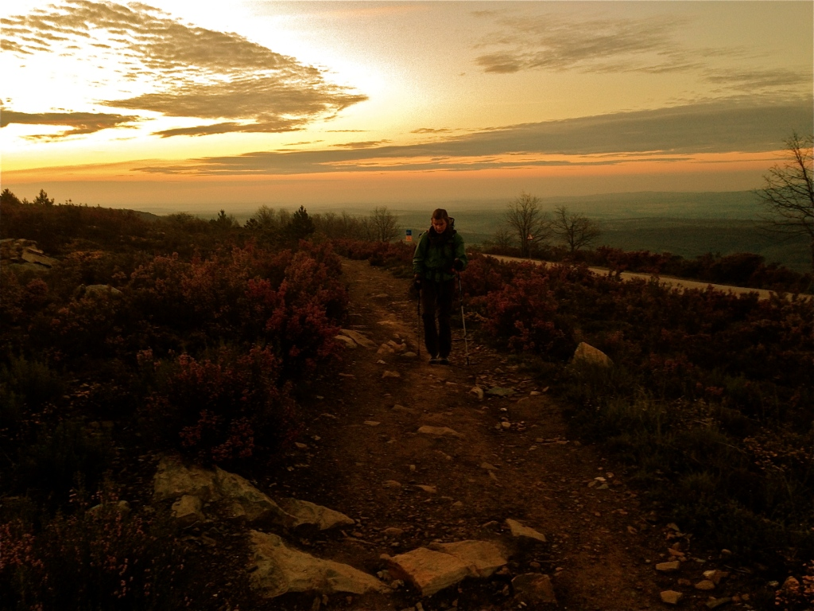
The Journey of Fifty Miles Begins with One Step

